Slide 1
S.W.O.T
USING SWOT ANALYSIS TO EXPLORE SECTOR INNOVATION

Slide 2
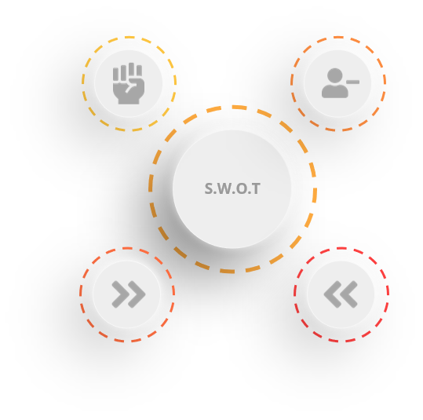
Overview
SWOT ANALYSIS
STRENGTHS
Outline the strengths that you can control.
What makes you stronger than your competitors,
what specialist skills do you have,
OPPORTUNITIES
Identify external factors that may be in your favour now or the near future
Is the technology stack strong
Are there upcoming events for positive impact
Are the market trends strong for your direction
WEAKNESSES
Be honest and face any underlying fears.
Is there a skill gap that needs to be filled
Are your processes effective?
Is the platform/market sustainable
He are you disadvantaged by your competitors
THREATS
Identify external factors that are not in your favour or may block your project
Is the technology stack/market weak
Are you aware of all standards (legal, social, ethical) in relation to your project
Could any of your identified weaknesses hinder your business?

Slide 3
Activity 01
SWOT ANALYSIS
Use SWOT to explore your enterprises ability to develop a:
A casual mobile game
Educational game
A tool to help develop a game
A tool to help promote sustainability
A platform to help motivate students to engage with course content

Slide 4
Exploring Your Individual Research Paper
SWOT ANALYSIS
STRENGTHS
WEAKNESSES
OPPORTUNITIES
THREATS
What is going well for the technology/topic,
What does it add to the field,
What are the common features that seem successful and why
What market trends support this technology/topic
What is not going well for the technology/topic,
What are the current limitations,
What needs further investigation
What are the market trends supporting
Can the market be expanded or re-focused
Is there an expanding market for this?
What workflows have serious shortcomings that need improvement?
What upcoming changes will support your tech/topic?
Can combining new technology solve old problems?
What is the longevity of any innovation?
Are there any issues with technology dependencies?
Are there upcoming changes in trends that might change the foundations of chosen technology/topic?
Any potential competition?

Slide 5
Research and Exploring Data
SWOT ANALYSIS
COMPARE + CONTRAST
This type of data easily summarises the similarities and differences between compared entities. However, this data still requires synthesis through the lens of your question and angle.
 | Feature A | Feature B | Feature C | Feature D
Software A | Yes | Yes | No | Yes
Software B | No | Yes | No | Yes
Software C | No | Yes | Yes | Yes but limited
TRENDS
https://www.wepc.com/news/video-game-statistics/
https://www.earnest.com/blog/the-demographics-of-video-gaming/
https://www.gamesparks.com/blog/the-average-gamer-how-the-demographics-have-shifted/

